Slide 1


Abhishek Deshpande
Getting Started with Plugin Development

Slide 2
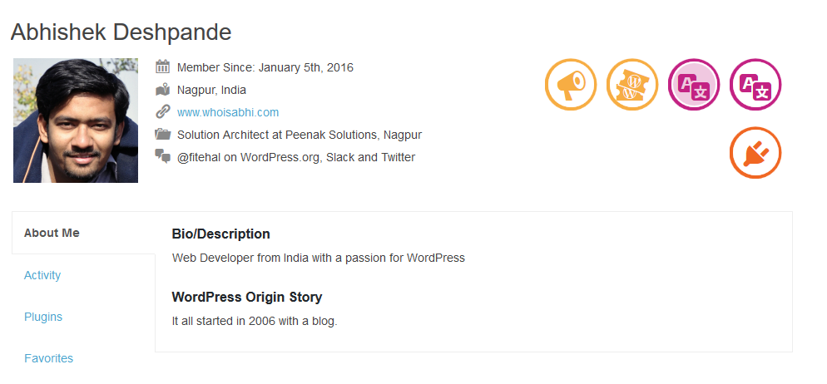

About Me

Slide 3
Why Plugins?
Notes:
Why We need Plugins
Why We create Plugins

Slide 4
What is a Plugin?
Plugin is package of code that extend the core functionality of WordPress.

Slide 5
How Plugin Works?
Hooks are a way for one piece of code to interact/modify another piece of code.
Two Types of Hooks : Actions, Filters

Slide 6
How Plugin Works?
Actions allow you to add data or change how WordPress operates
Actions = Do Something
Details: https://codex.wordpress.org/Plugin_API/Action_Reference

Slide 7
How Plugin Works?
Filters give you the ability to change data during the execution of WordPress.
Filters = Transform
Details: https://codex.wordpress.org/Plugin_API/Filter_Reference

Slide 8
How to create a Plugin
What will plugin do?
Make a Plan
Follow Plugin Development recommendation

Slide 9
Plugin Directory Structure
Your Plugin
/wp-content/plugins/my-plugin
Inside my-plugin Folder
readme.txt
my-plugin.php
Notes:
Prefer Directory
Always use dash not Underscore

Slide 10
Inside my-plugin.php
Plugin Header
Hooks
PHP Code
Notes:
Prefer Directory
Always use dash not Underscore

Slide 11
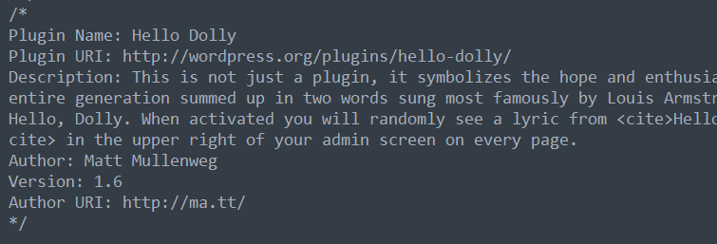
Inside my-plugin.php
Plugin Header
PHP Code
Hooks
Notes:
Prefer Directory
Always use dash not Underscore

Slide 12
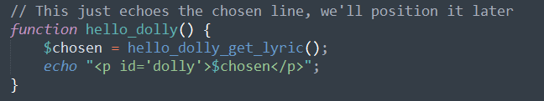
Inside my-plugin.php
Plugin Header
PHP Code
Hooks
Notes:
Prefer Directory
Always use dash not Underscore

Slide 13
Inside my-plugin.php
Plugin Header
PHP Code
Hooks
Notes:
Prefer Directory
Always use dash not Underscore

Slide 14
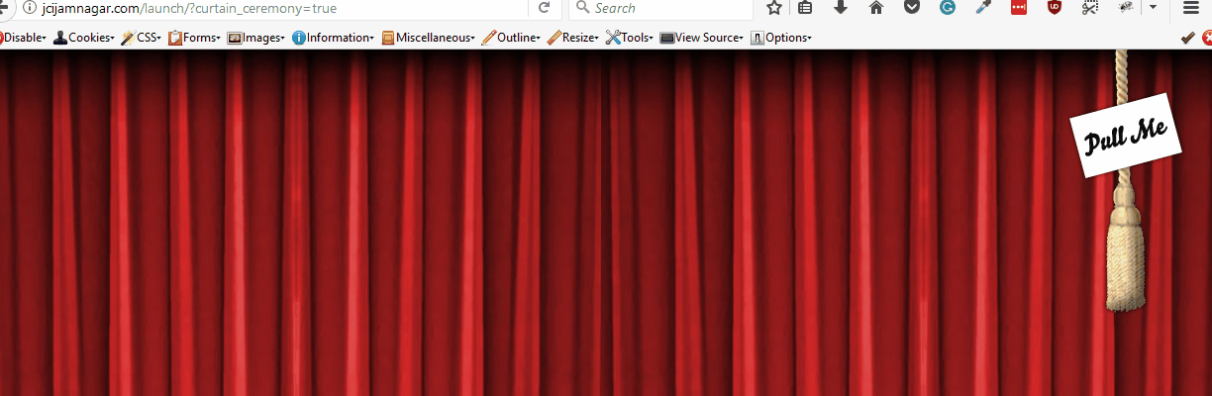
Website Inauguration Ceremony

Slide 15
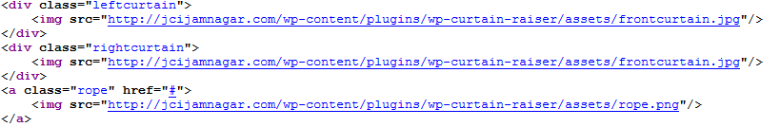
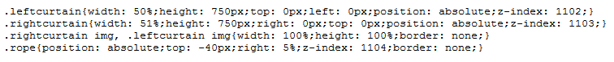
Website Inauguration Ceremony : HTML & CSS

Slide 16
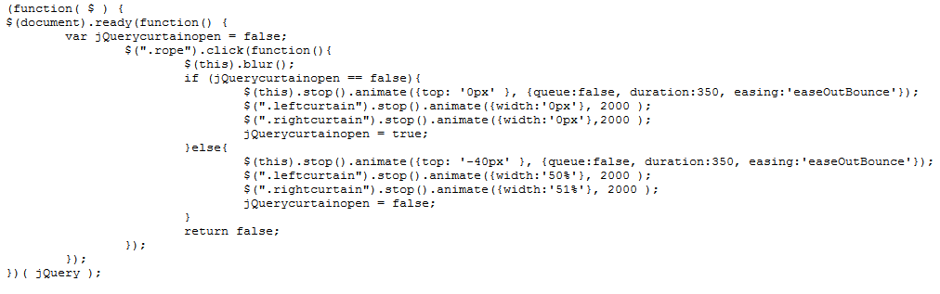
Website Inauguration Ceremony : JavaScript

Slide 17
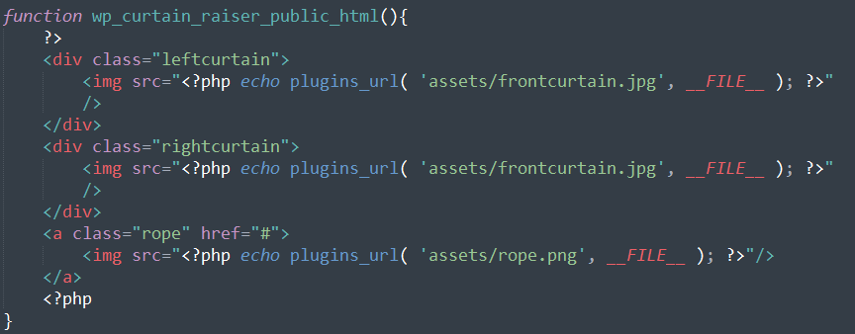
WP Curtain Raiser

Slide 18
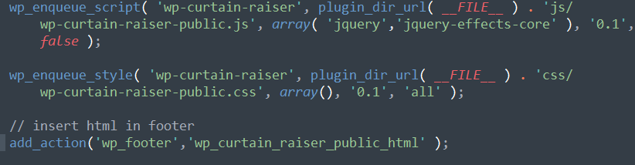
WP Curtain Raiser

Slide 19
Best Practices
Find Unique Name for your Plugin
Setup a Plugin Prefix (can be your brand name)
Use Proper constants and functions to detect paths to Plugin files.
Keep your code readable & well documented.
Notes:
Prefer Directory
Always use dash not Underscore

Slide 20
Various API and Components
Shortcodes, Widgets, Menu’s
HTTP API, Options API, Settings API, Transient API, Rewrite API
Custom Post Types, Taxonomies, meta boxes, page templates
Notes:
Prefer Directory
Always use dash not Underscore

Slide 21
Some Plugins by People in this Camp
Blogger to WordPress
Give Donation Plugin
Documentor
WP Curtain Raiser
Pirate Forms
Awesome Studio
WordCamp Dashboard Widget
Custom CSS For WordPress
Page Visit Counter
Advanced WP Testimonials

Slide 22

Questions
Please ?

